Slide 1
SDO Client SDK Documentation Images

Slide 2
Slide | Original document label | Markup link
3 | 1-Intel SDO Client Block Diagram.JPG
4 | 2-Integrated Image and Execution Flow.JPG
5 | 3-Service Info Exchanges between Device and Owner Server.JPG

Slide 3
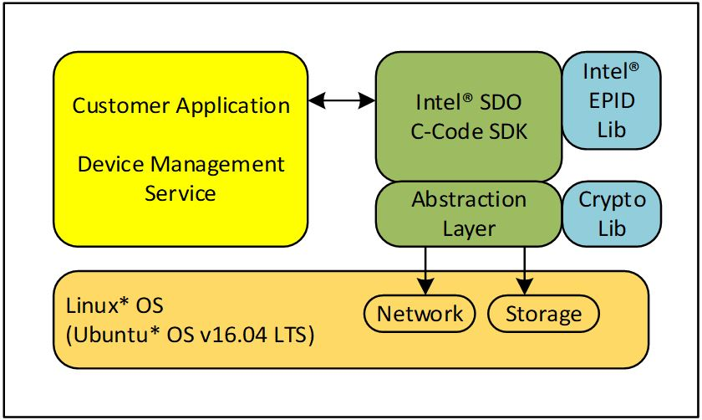
SDO
Client SDK

Slide 4
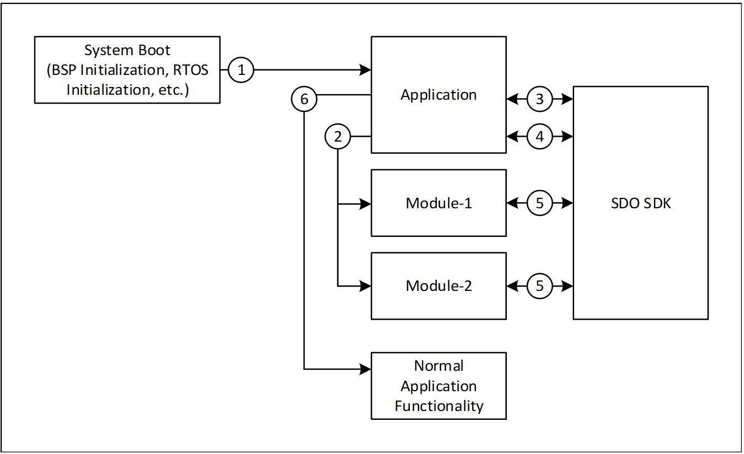
SDO
Client SDK

Slide 5
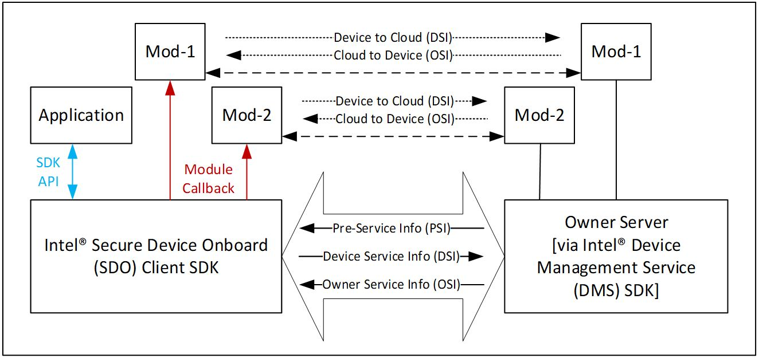
Secure Device Onboard
(SDO)
Client SDK
Owner Service
(via IOT Platform SDK)

